Slide 1
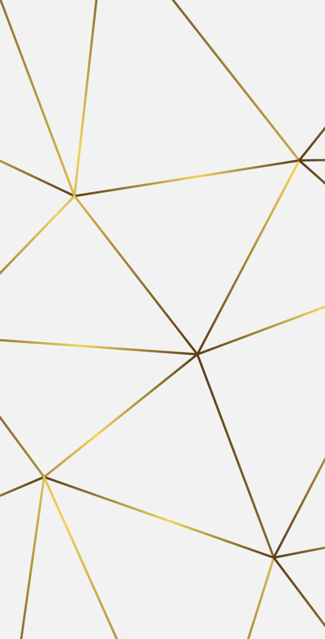
Standalone simulations (Glass Simulations)
Bhavya Singhal, Shin-Shan Eiko yu

Slide 2
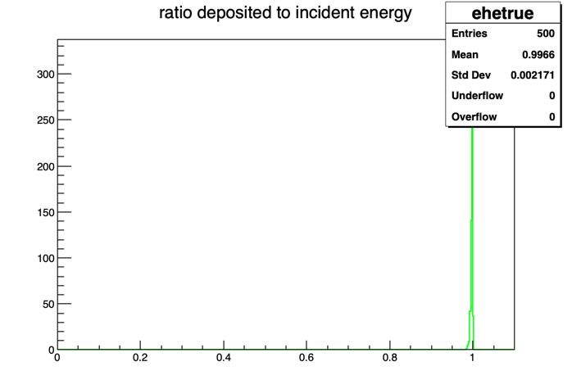
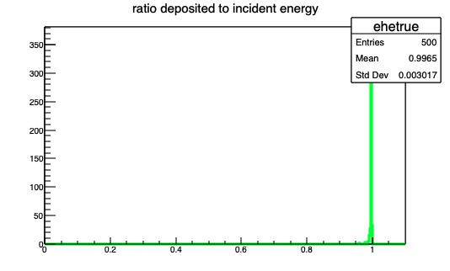
(Fraction of Deposited Energy)

Slide 3
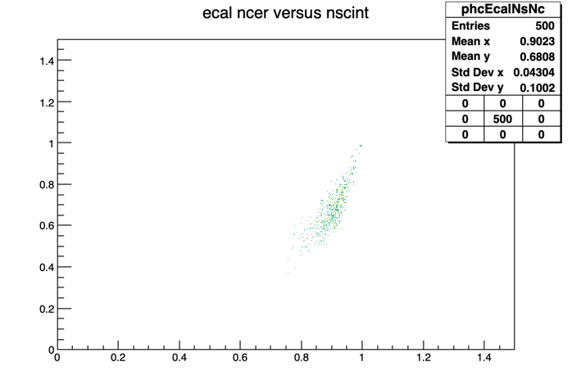
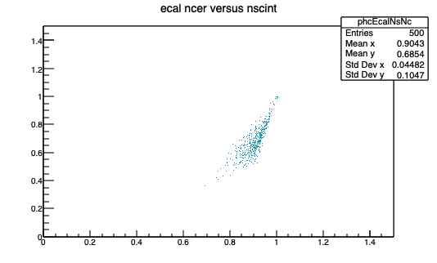
Master vs V1.0.0
(Cherenkov vs Scintillation )

Slide 4
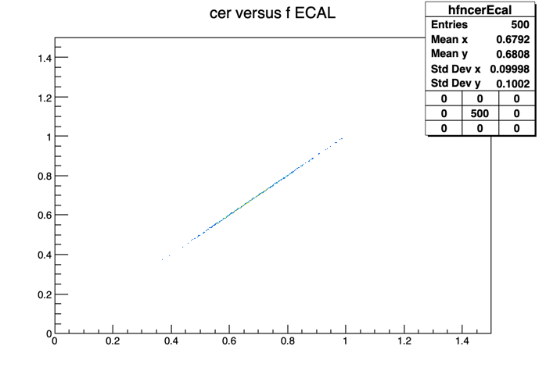
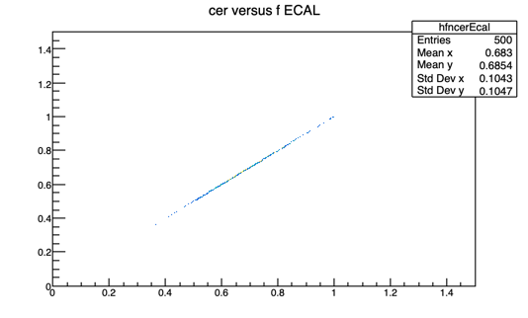
Master vs V1.0.0
(Cherenkov vs EM object fraction)

Slide 5
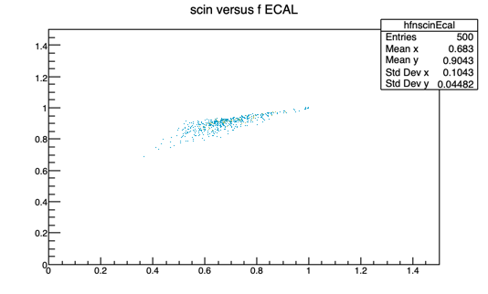
Master vs V1.0.0
(Scintillation vs EM object fraction)

Slide 6
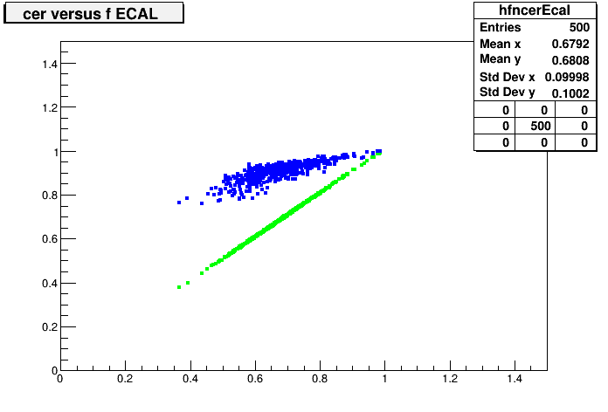
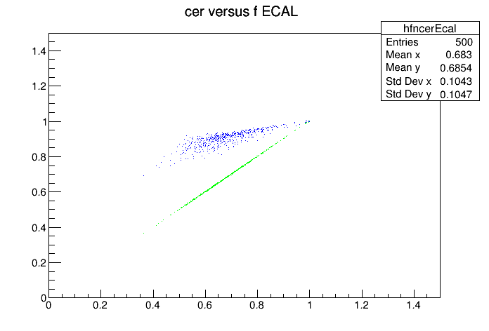
Master vs V1.0.0
(Cherenkov(green) and Scintillation(blue) vs EM object fraction)

Slide 7
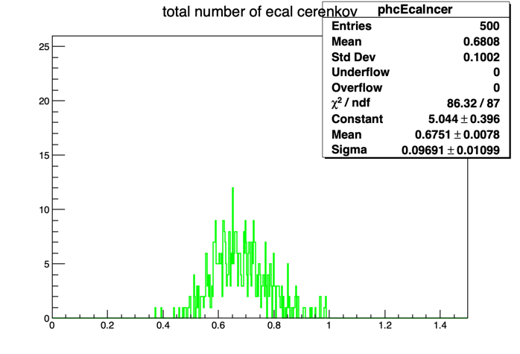
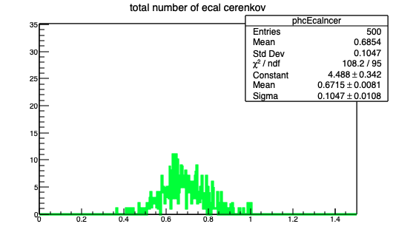
Master vs V1.0.0

Slide 8
Simulations studies for Glass
Tried reproducing the simulation plots for PbWO4 and compared with the ones in arxiv: 2501.15329v3.
The simulations were generated for 2000 events.
We also generated those plots for a template Glass(ABS) description for ECAL, replacing PbWO4.
Glass_ABS is defined for Glass Scintillator.
Scaled down the Refractive index for ABS using PBWO4 R-index.
Rest of the parameters are kept similar to PBWO4

Slide 9
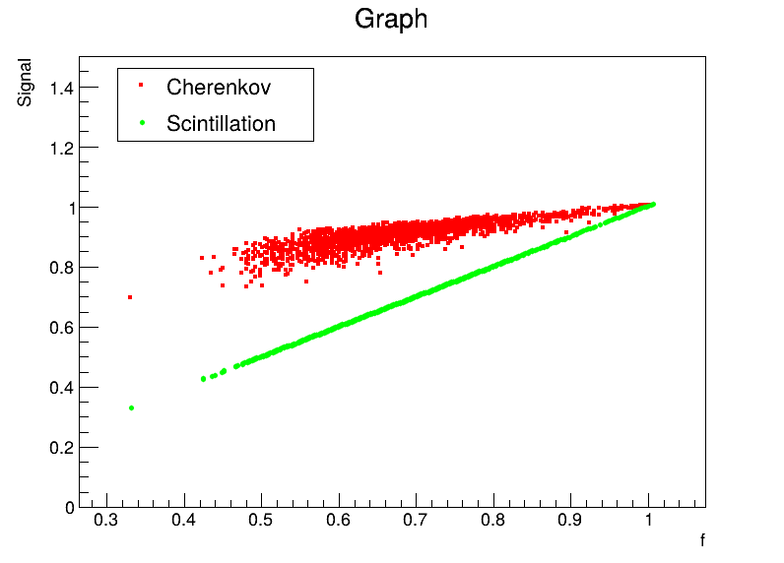
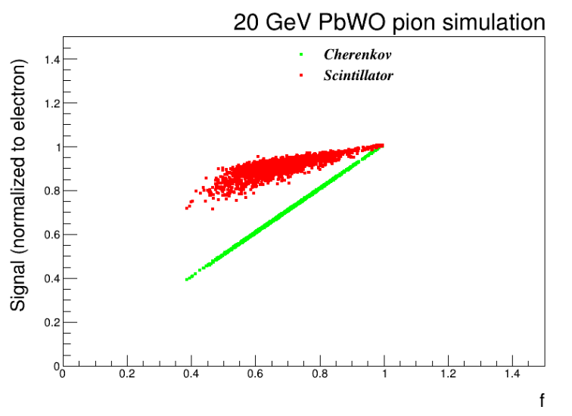
Simulations vs 2501.15329v3

Slide 10
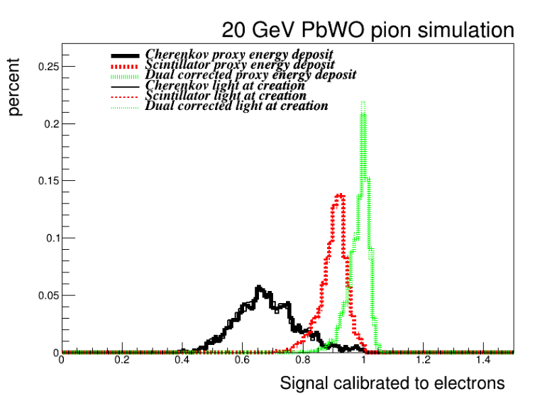
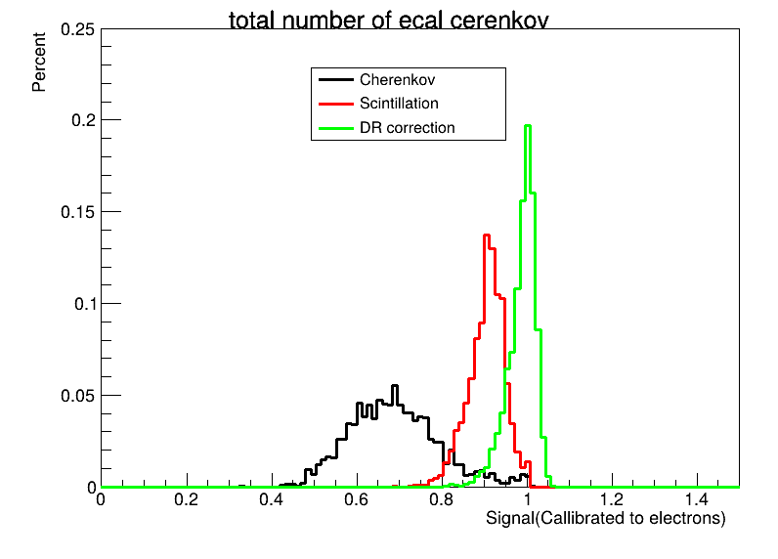
Simulations vs 2501.15329v3

Slide 11
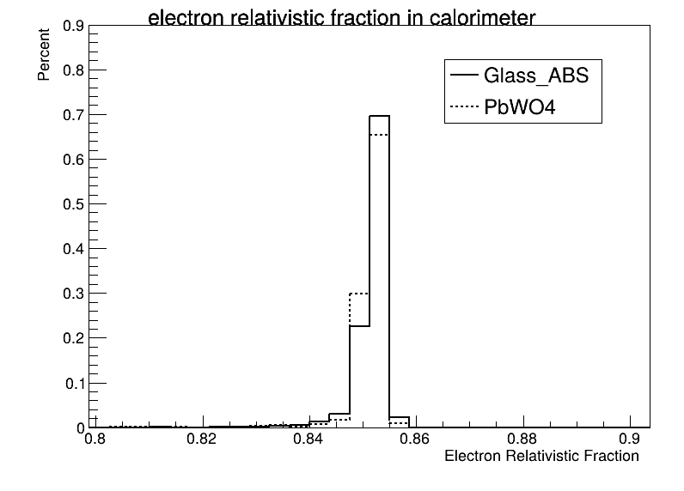
Glass vs PbWO4(2000 Events)
Fraction of deposited ionizing energy in 20 GeV electron showers deposited by particles Fraction of deposited ionizing energy in 20 GeV electron showers deposited by particles

Slide 12
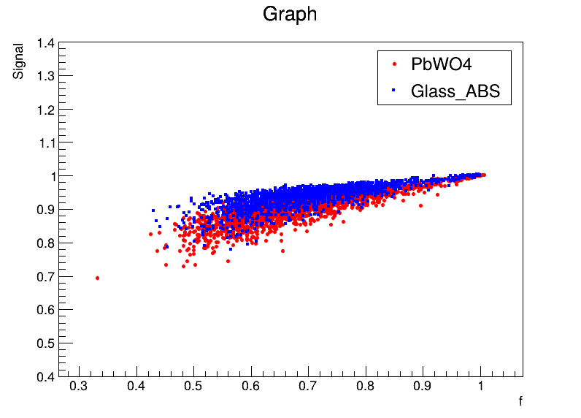
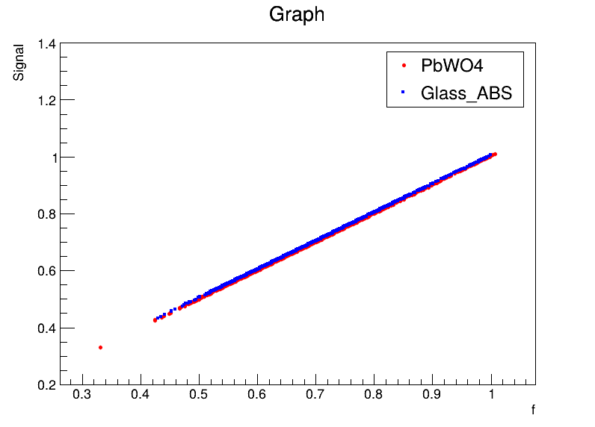
Glass vs PbWO4(2000 Events)
Scintillation Signal
Cherenkov Signal

Slide 13
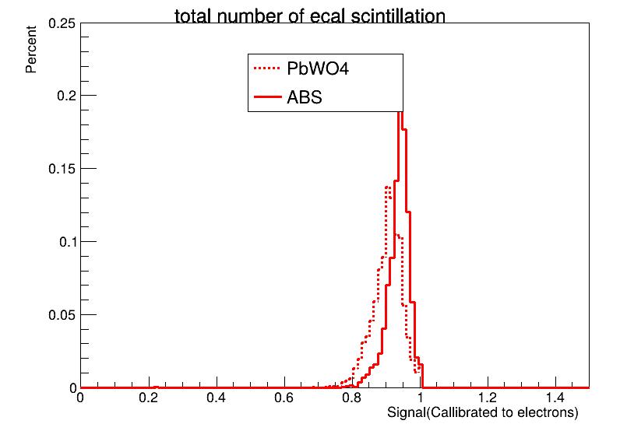
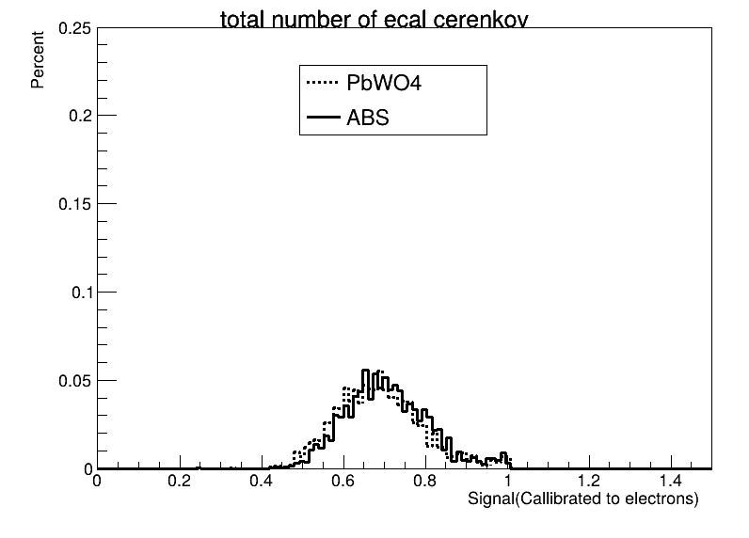
Glass vs PbWO4(2000 Events)

Slide 14
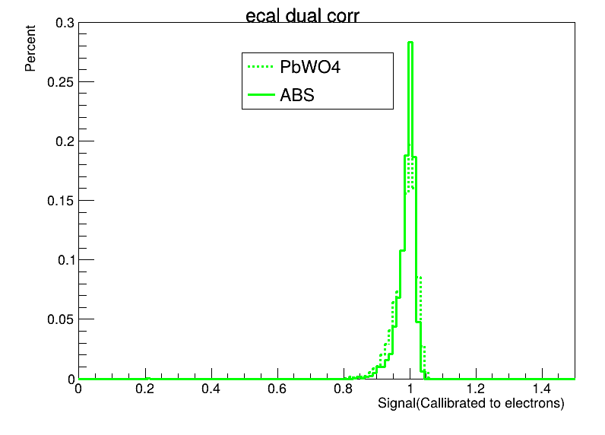
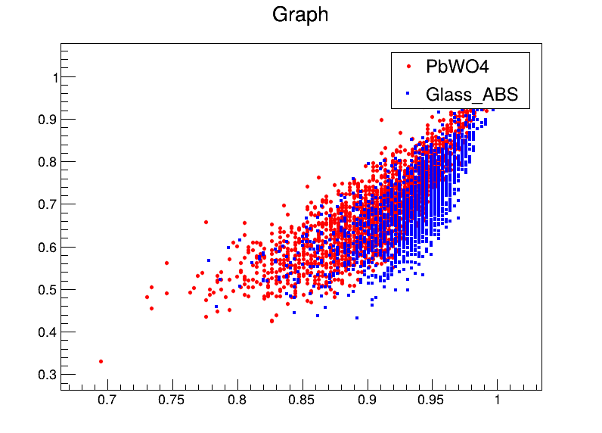
Glass vs PbWO4(2000 Events)
Cherenkov versus scintillation signal for calorimeters
Dual Readout Correction

Slide 15
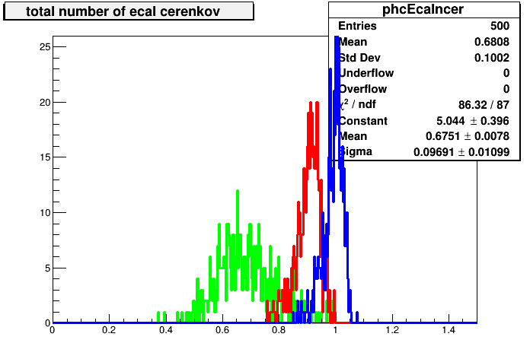
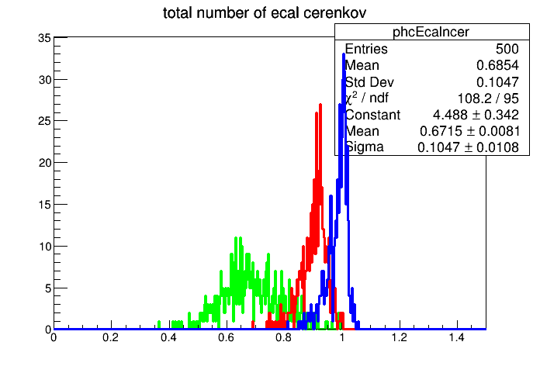
Master vs V1.0.0

Slide 16
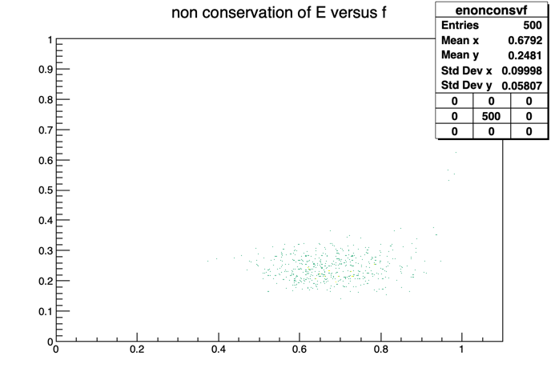
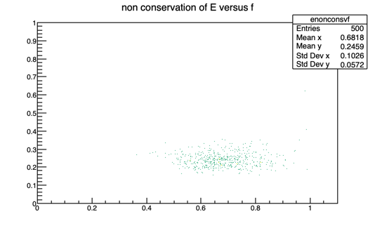
Master vs V1.0.0

